Slide 1
Welcome to 6th Grade with: Mrs. Nicole Brawley, Mrs. Tina Croes, and Mr. Ryan Miller

Slide 2
Our Focus: Prepare for college and increase opportunities.

Slide 3
WEB Where Everybody Belongs
Goal: 8th grade leaders peer mentor 6th grade students to break down the walls separating grade level from grade level and student group from student group.

Slide 4
WEB PROGRAM
Orientation: 8th grade and staff run orientation and introduce 8th grade leaders to their year long groups.
Academic Follow-ups: 8th graders continue to follow up both academically and socially with students throughout the year.

Slide 5
Preparing for College: •College adoption by homeroom •Homeroom August 22 – October 1st ✓ 1st six weeks are designed to give students the tools to enhance college readiness . ✓ We believe students should have the opportunity to choose college.

Slide 6
A.V.I.D.
Advancement Via Individual Determination
Begins October 2nd
• Students learn organizational and study skills, work on critical thinking and ask probing questions, get academic help, and participate in enrichment and motivational activities that make college seem attainable.
✓ Team building and trust
✓ Organization – Portfolio Checks
✓ Tutorials
✓ Cornell Notes

Slide 7
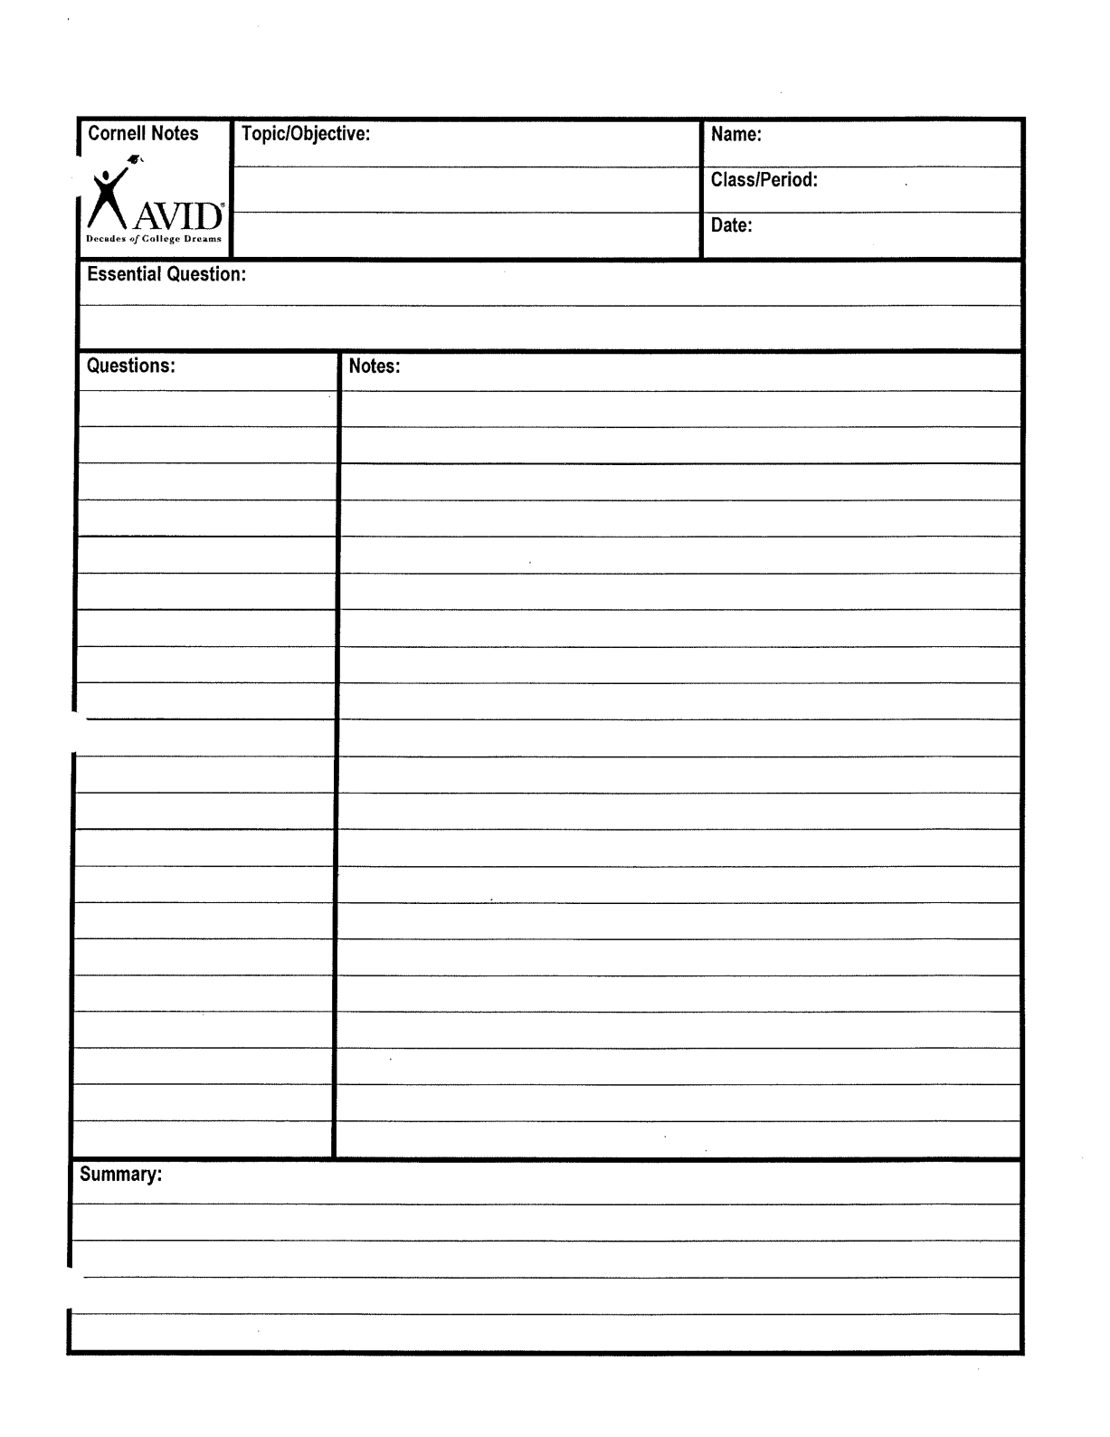

Slide 8
The Beauty of Organization!
High school teachers were asked what skills their students should have upon entering high school.
The #1 answer: ORGANIZATION
As a 6th grade team we have provided a specific system to help keep your child organized with their many classes, homework, tests, and projects.

Slide 9
Planners and Binders
Each student is asked to write in their planner as he/she visits each class. Some teachers have them write ONLY homework and others combine class work and homework.
Each assignment is kept in a specific location in their binder according to the class and assignment number.

Slide 10
Assignment Log
Each assignment is given an assignment number. That number becomes the page in that section of their binders.
Students are expected to keep an updated Assignment Log page along with their numbered assignments until a Portfolio/Binder Check is announced.
The Portfolio/Binder grades include points for completed work, organization of the assignments, and correct assignment log page.

Slide 12
Accelerated Reader
AR is worth 20% of the student’s grade in Literature.
Library day is every Wednesday.
Students keep all the necessary paperwork (logs and ZPD range) in the Literature section of their binder.

Slide 13
How AR Works
Every trimester students take a STAR test to determine their reading range (ZPD).
Students are given points according to their individual levels.
Required to log minutes read at home and then take an AR quiz at school.
Each log is due at the end of the month and must be signed by a parent/guardian.
AR points are due on Oct. 18th.

Slide 14
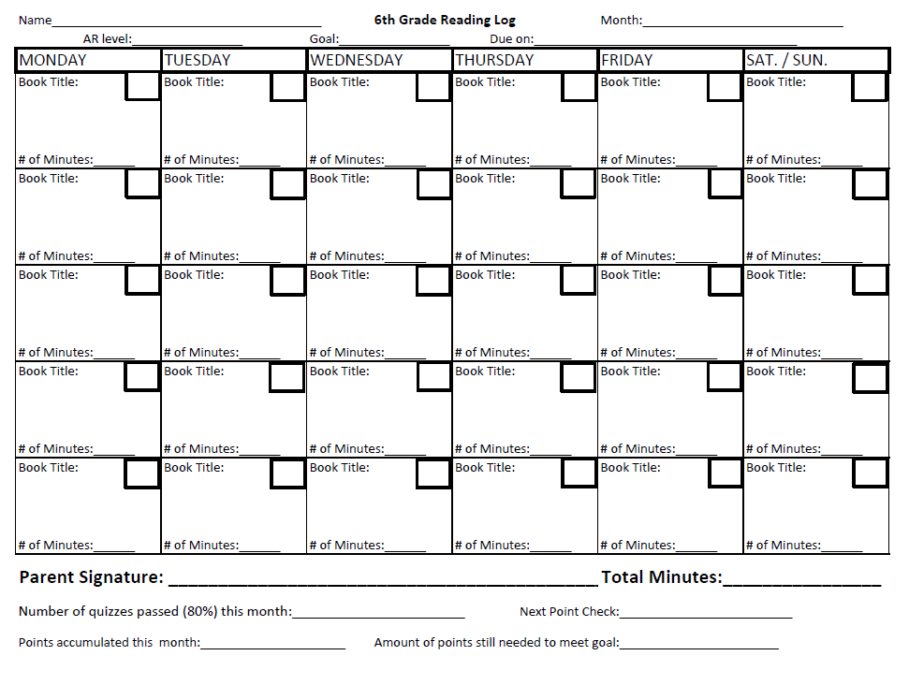

Slide 15
AR LINKS
AR Book Finder- Look up any book that is not from BC Library at this website.
http://www.arbookfind.com/UserType.aspx
Here you can find the AR level, point value, and AR quiz number.

Slide 16
Online Grades
Updated Weekly (Mondays)
Progress Reports
Every three weeks
First progress report – Monday, September 10th
Parent/Student Log In
http://sis.enterprise.k12.ca.us/public

Slide 17
Classroom Webpages
Check Regularly
Parent/Student Log In
http://www.bouldercreekbrawley.weebly.com
http://www.bouldercreekcroes.weebly.com
http://www.bouldercreekmiller.weebly.com
You will find:
Announcements
Homework
Links/Resources
And much more!

Slide 18
COMMUNICATION
Student Planner
Students complete their planners daily. This is the first place parents should look for homework.
Teacher’s Webpage – homework information and class announcements
- http://www.bouldercreekbrawley.weebly.com
- http://www.bouldercreekcroes.weebly.com
- http://www.bouldercreekmiller.weebly.com
Online Grades and Progress Reports
Online grades are available daily.
Grades are posted in class at least once per week.
Progress Reports will be sent home every three weeks.
Parent/Teacher Conferences at the end of first and second trimesters
Report cards at the end of each trimester
Email
nbrawley@eesd.net
tcroes@eesd.net
rmiller@eesd.net
Phone
224-4140

Slide 19
THANK YOU
We sincerely appreciate the opportunity to work with your sons and daughters this year. Together, they make a wonderful middle school class.
And when we – teachers and parents – work together, we increase the success of our children tremendously!

