Slide 1
Welcome to 6th Grade with:
Mrs. Nicole Brawley,
Mrs. Tina Croes, and Mrs. Jennifer Lane

Slide 2
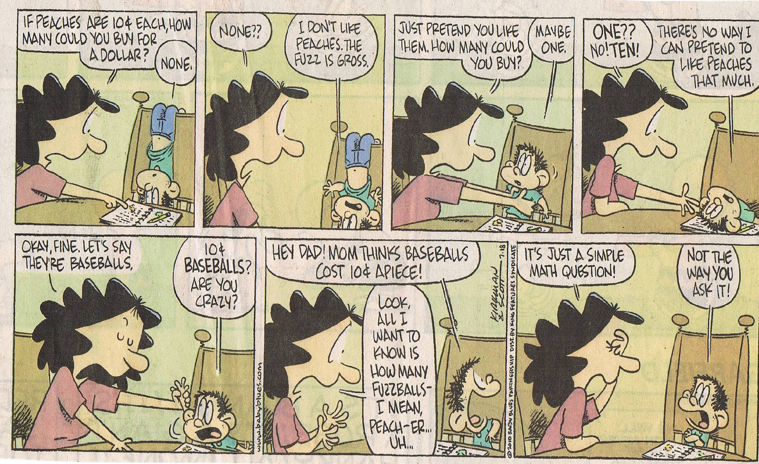
You may have similar experiences with your sixth grader. Don’t panic, we are in this together!

Slide 3
The Beauty of Organization!
High school teachers were asked what skills their students should have upon entering high school.
  The #1 answer: ORGANIZATION
As a 6th grade team we have provided a specific system to help keep your child organized with their many classes, homework, tests, and projects.

Slide 4
Planners and Binders
Each student is asked to write in their planner as they visit each class. Some teachers have them write ONLY homework and others combine class work and homework.
Each assignment is kept in a specific location in their binder according to the class and assignment number.

Slide 5
Tables of Contents/Assignment Log
Each assignment is given an assignment number. That number becomes the page in that section of their binders.
Students are expected to keep an updated Table of Contents/Assignment Log page along with their numbered assignments until a Portfolio/Binder Check is announced.
The Portfolio/Binder grades include points for completed work, organization of the assignments, and correct table of contents page.

Slide 6
A.V.I.D.
Advancement Via Individual Determination
Students learn organizational and study skills, work on critical thinking and ask probing questions, get academic help, and participate in enrichment and motivational activities that make college seem attainable.
Students are taught how to take Cornell notes for all academic classes.
Students will be graded on organization, tutorials, participation, and note taking.

Slide 7
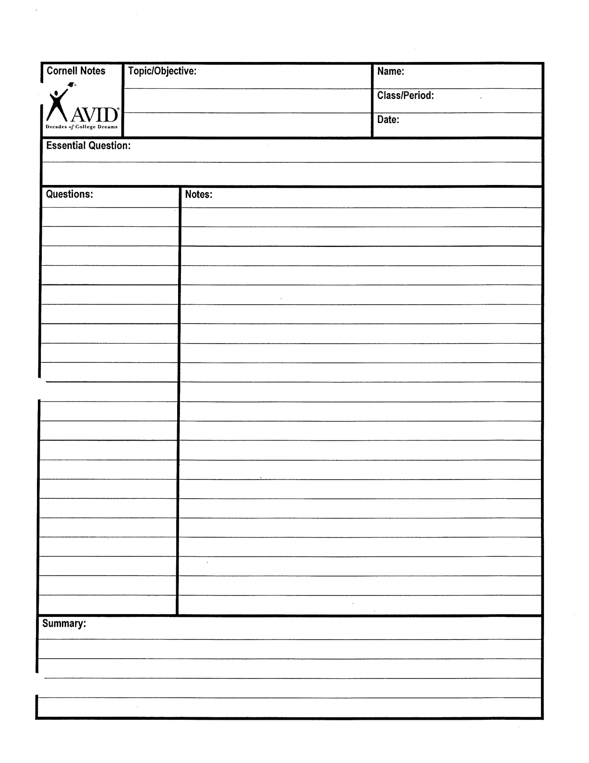

Slide 8
Accelerated Reader
AR is worth 20% of the student’s grade in Literature.
Library day is every Wednesday.
Students keep all the necessary paperwork (logs and ZPD range) in the Literature section of their binder.

Slide 9
How AR Works
Every trimester students take a STAR test to determine their reading range (ZPD).
Students are given points according to their individual levels.
Required to log minutes read at home and then take an AR quiz at school.
All SIGNED logs and quizzes are due on Oct. 25th.

Slide 10
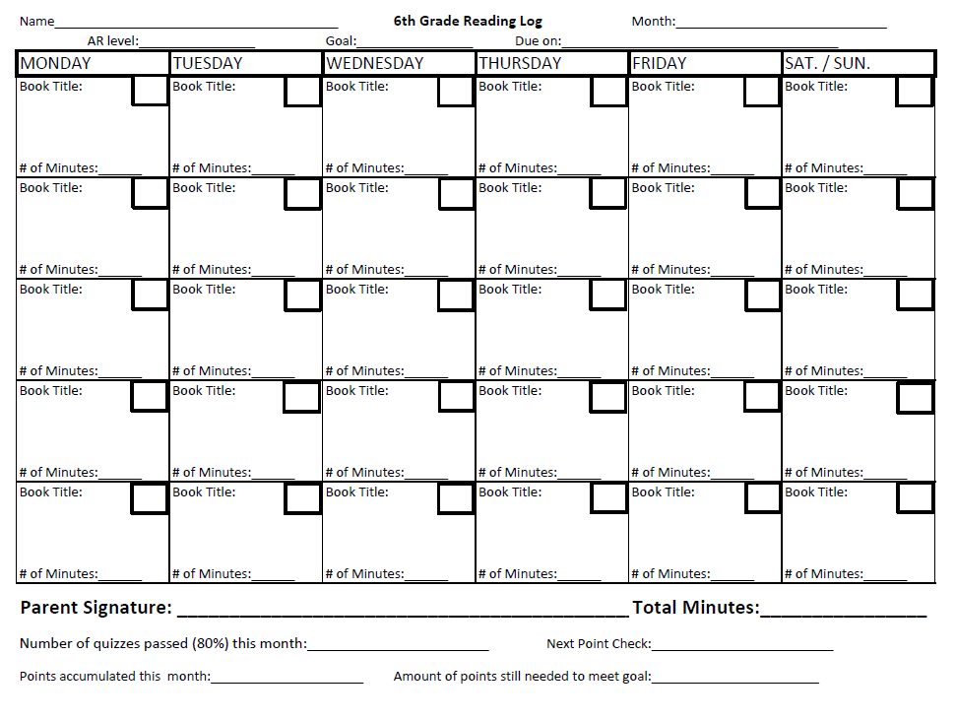

Slide 11
AR LINKS
AR Book Finder- Look up any book that is not from BC Library at this website.
http://www.arbookfind.com/UserType.aspx
Here you can find the AR level, point value, and AR quiz number.

Slide 12
Online Grades
Updated Weekly (Fridays)
Progress Reports
  Every three weeks
    First progress report – Monday, September 12th
Parent/Student Log In
http://sis.enterprise.k12.ca.us/public

Slide 13
Classroom Webpages
Check Regularly
Parent/Student Log In
http://www.bouldercreekbrawley.weebly.com
http://www.bouldercreekcroes.weebly.com
http://www.bouldercreeklane.weebly.com
You will find:
  Announcements
  Homework
  Links/Resources
  And much more!

Slide 14
COMMUNICATION
Student Planner
  Students complete their planners daily. This is the first place parents should look for homework.
Teacher’s Webpage – homework information and class announcements
- http://www.bouldercreekbrawley.weebly.com
- http://www.bouldercreekcroes.weebly.com
- http://www.bouldercreeklane.weebly.com
Online Grades and Progress Reports
  Online grades are available daily.
  Grades are posted in class at least once per week.
  Progress Reports will be sent home every three weeks.
  Parent/Teacher Conferences at the end of first and second trimesters
  Report cards at the end of each trimester
Email
  nbrawley@eesd.net
  tcroes@eesd.net
  jlane@eesd.net
Phone
  224-4140

Slide 15
THANK YOU
We sincerely appreciate the opportunity to work with your sons and daughters this year. Together, they make a wonderful middle school class.
And when we – teachers and parents – work together, we increase the success of our children tremendously!

